Slide 1
Mobile Application Development Project
Incharge: Namratha M

Slide 2
Course Registration System
Team Members:
Saumya Shanu 1BM17CS091
Ranispoorti Patil 1BM17CS073
Rohini 1BM17CS078
Meghana HL 1BM17CS412

Slide 3
Project Description
Course Registration system will help the student to gather information about a particular course and then they can easily register them self in a particular course. Course Registration app is designed to make the college course registration more easily accessible and more convenient for students, admin and other staff too. It is aimed at reducing the effort involved in traditional course registration process in the college.

Slide 4
Purpose
System will allow the registration of students in particular course.
System has inbuilt validation system to validate the entered data.
Student can login into system by using username and check the details of course, faculty and department.

Slide 5
Features
App provides the following features :
The user enters the username and password and chooses if the user is student or administrator. If entered details are valid, the user’s account becomes available.
A Student can search all the courses available to him and he chooses the best course for wants. The student can view course duration, faculty and department of the course.
When a student has chosen a course, he can register to that course. Upon registration, the student’s details are stored in database.
A student can register or re-register to a course.

Slide 6
5. After registration to any course, the student may see the details of current course. He may wish to know details about fees and other information.
6. The database is updated on every transaction and administrator can view the details.

Slide 7
UI Features
Some of the UI features of the app are :
Login page
Dashboard.
In the side menu :
Register
Re-register
Profile icon to update profile information
Notification

Slide 8
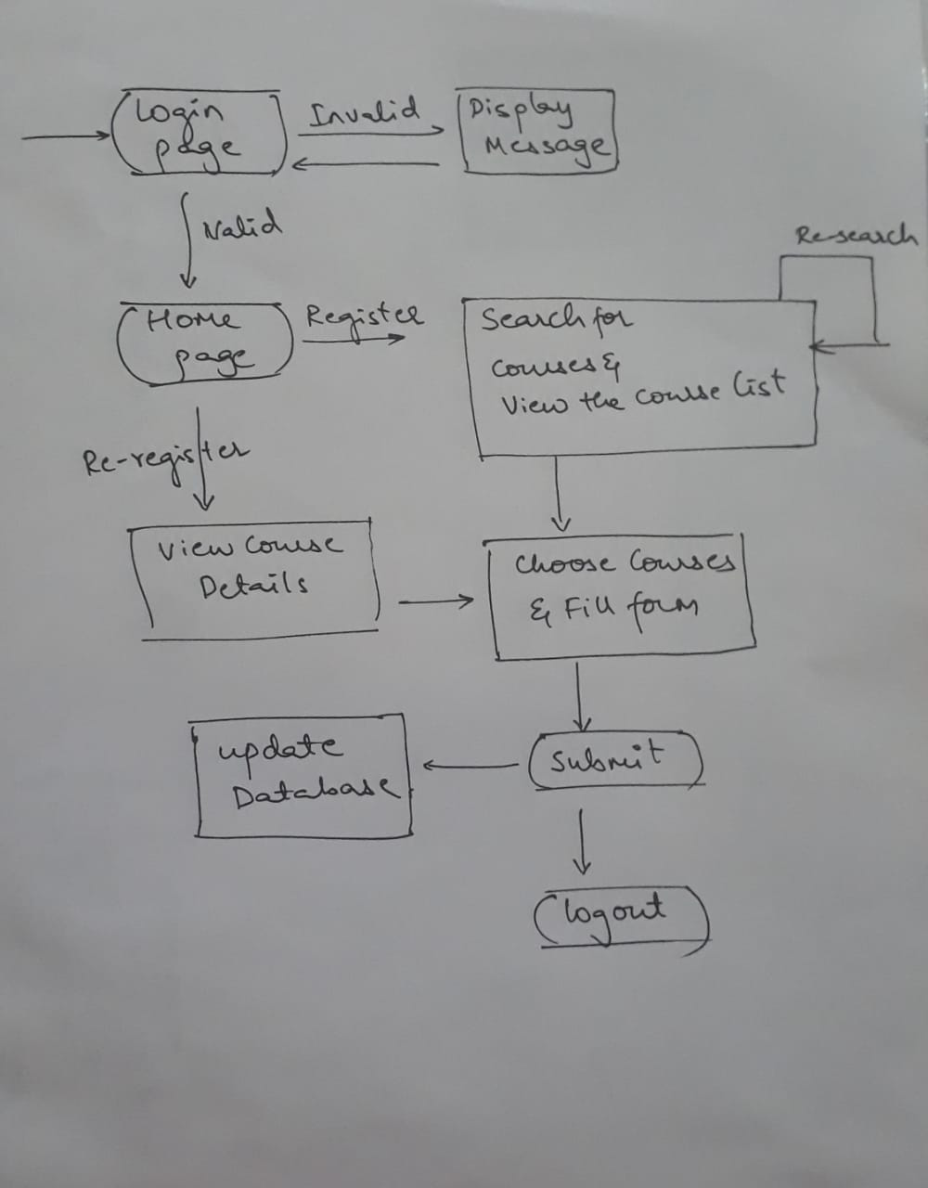
FlowChart

Slide 9
Merits
It reduces the efforts put in traditional process where in everything is done in the college.
The department can easily gather information from database without processing.
Easily accessible for both students and administrator from anywhere and anytime.

Slide 10
Future Developments
After successful submission, system will give unique registration no for each student.
After registration, system can provide all the required materials and document for a particular course. And the list for the lab if associated.
System can also display the results after the completion of the registered course.
Student can apply for revaluation or the photocopy or challenged revaluation after viewing the results.

Slide 11
Thank You

